Slide 1
Energy Consumption Analysis
Energy Consumption Analysis
A Data-Driven Approach to Understanding Energy Usage

Slide 2
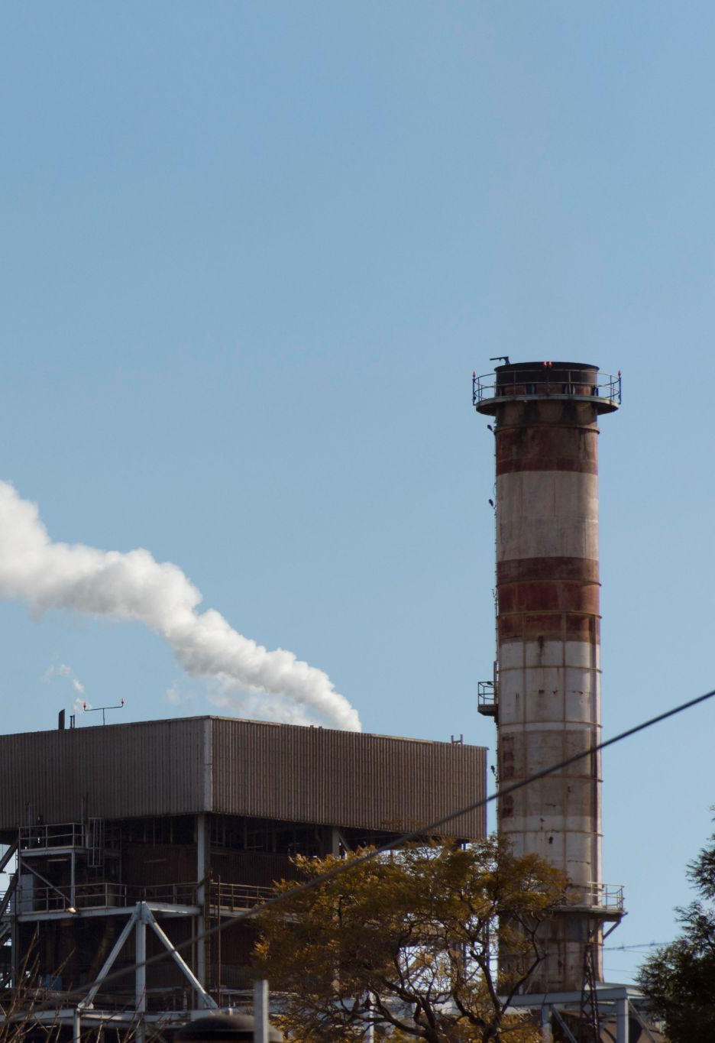
Introduction
Project Overview
Title: Energy Consumption Analysis & Optimization
Goal: To analyze energy consumption patterns and identify opportunities for optimizing energy usage to reduce costs and improve efficiency.
Motivation
The growing demand for energy, coupled with the need for sustainable practices, makes it crucial to understand consumption patterns.
Optimizing energy usage leads to cost savings, energy efficiency, and environmental benefits.
Objectives
Explore consumption patterns and trends.
Detect anomalies and outliers in the energy data.
Calculate potential energy savings and cost reductions based on different demand levels.

Slide 3
Table of content
01
02
03
04
05
Data Collection
Data Exploration and Analysis
Data
Insights
Statistical Hypothesis Testing
Threshold Recommendation and Cost Savings

Slide 4
01
Data Collection

Slide 5
Data Sources
Sites Energy Consumption Data
Demand Data
DateTime: Timestamp of energy consumption.
Site_id: unique site identifier contains more than one cell.
Cell_id: unique cell identifier.
Region: geographical area that identifies site location.
KWH/hh (per half hour): Energy consumed in half hour intervals.
Rows: 1,380,252 records
Columns: 5
DemandDateTime: Timestamp corresponding to the demand data.
Demand: Categorical field indicating the demand level (High, Normal, High).
Rows: 17,520 records
Columns: 2

Slide 6
02
Data Exploration and Analysis

Slide 7
Exploratory Analysis
Data Overview
Describe Data
Inspecting the first and last few rows to understand the structure
Statistical overview of the dataset
Data Structure
Data Distribution
Understand the basic structure of the dataset
Plotting histograms and box plots to visualize the distribution of data features

Slide 8
Data Cleaning and Preparation
Handle Missing Values
Drop Duplicates
The dataset has no missing values.
There are 942 duplicate rows, which have been removed to maintain data quality and avoid bias
Change Date Format
Data Consistency
Merging
Convert the 'DateTime' column, from an object (string), into a datetime format for easier time-based analysis and manipulation
Standardized column names and values for consistency and clarity across the dataset.
Merged `sites_energy` and `demand` DataFrames on the 'DateTime' column to consolidate data.

Slide 9
Anomaly Detection
Objective
To identify and handle anomalies in the KWH/hh (per half hour) column to ensure data quality and consistency.
Steps Applied
Calculated IQR (Interquartile Range):
Q1 (25th Percentile): Found the lower quartile.
Q3 (75th Percentile): Found the upper quartile.
IQR: Calculated as 𝐼𝑄𝑅=𝑄3−𝑄1IQR=Q3−Q1.
Determined Outlier Boundaries:
Upper Bound: 𝑄3+1.5×𝐼𝑄𝑅Q3+1.5×IQR
Lower Bound: 𝑄1−1.5×𝐼𝑄𝑅Q1−1.5×IQR
Identified Outliers:
Detected 120,217 rows with outlier values.
Replaced Outliers:
Replaced all outlier values with the median value of the KWH/hh (per half hour) column.
Outcome
Successfully handled anomalies, resulting in a cleaner and more reliable dataset.

Slide 10
Demand Prices
Objective
This step involves calculating the energy cost for each entry in the DataFrame based on the demand type and the corresponding price per kWh.
Mapping Demand Prices
The demand column in the DataFrame is mapped to its corresponding price per kWh using the demand_prices dictionary. The prices are assigned to a new column, 'Demand Price’.
Calculating Energy Cost
The 'Energy Cost' is then computed by multiplying the 'KWH/hh (per half hour)' by the 'Demand Price' for each row. This gives the total cost of energy consumption for each half-hour period.
Benefits
This process allows for dynamic energy cost calculation based on demand and consumption data.
Demand | Demand Price
High | 77.21
Normal | 19.46
Low | 6.89

Slide 11
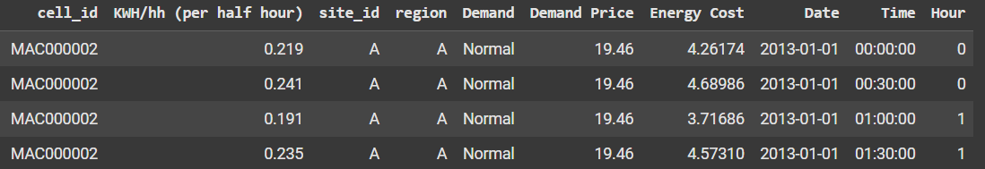
Feature Engineering
Objective
To derive meaningful features from the DateTime column for better temporal analysis.
Steps Applied
Extracted Date and Time from the DateTime column.
Derived the Hour feature for hourly trend analysis.
Dropped the original DateTime column for simplicity.
Benefits
Enables focused analysis of daily, hourly, and time-specific patterns in energy consumption.
Simplifies data structure for downstream analysis and modeling.
Outcome
The dataset now contains more interpretable and analysis-friendly time-related features.

Slide 12
03
Data Insights

Slide 13
210.13K
4.43M
Total Energy Cost
Total Energy Consumption (KWh)

Slide 14
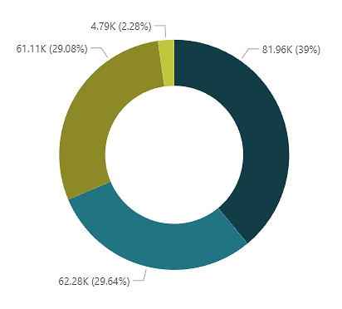
Total Energy Consumption by Region
Region A
39%
Region B
29.64%
Region C
29.08%
Region D
2.28%

Slide 15
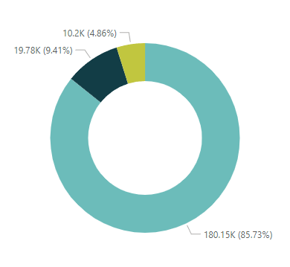
Total Energy Consumption by Demand
Normal Demand
85.73%
Low Demand
9.41%
High Demand
4.86%

Slide 16
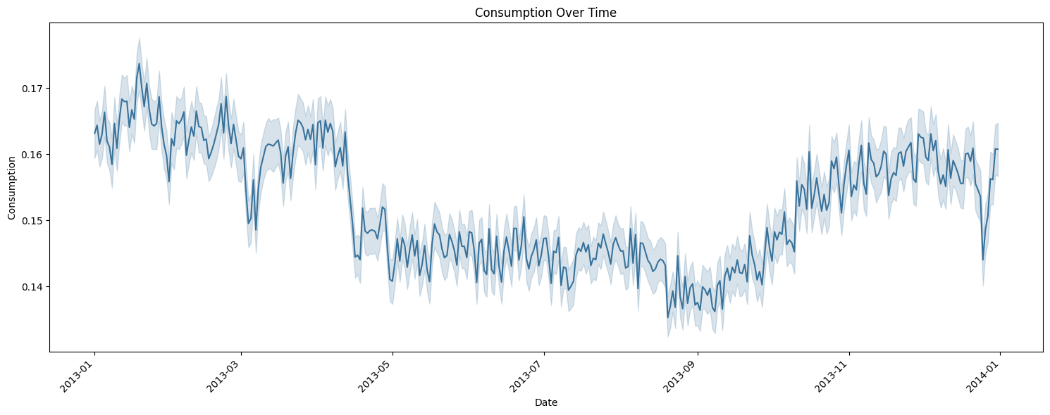
Energy Consumption Over Time
Fluctuations in consumption are evident, with certain periods showing more significant variation.
There is a seasonal increase towards the end of 2013, suggesting external factors like temperature changes could be influencing consumption patterns.
The sharp rise in early 2014 could merit further investigation to understand if it is due to changes in demand, policy, or external influences.

Slide 17
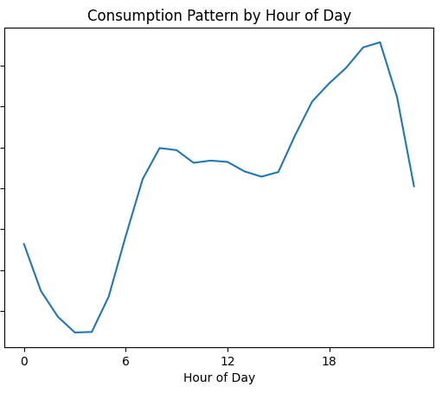
Average Energy Consumption by Hour of Day
The highest consumption occurs during the evening hours (18:00–24:00), likely related to increased household activities.
The lowest consumption is observed during the early morning hours (00:00–06:00), which is typical for most residential areas due to fewer activities taking place.
Steady consumption in the late morning and early afternoon could suggest stable, continuous demand, potentially related to work hours or base usage.

Slide 18
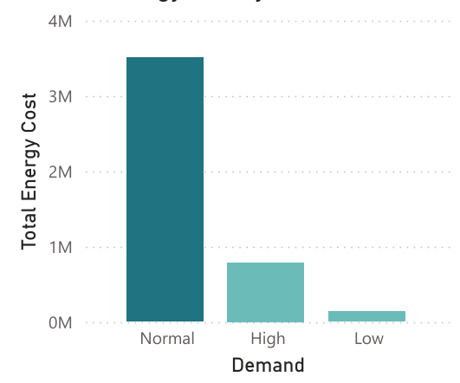
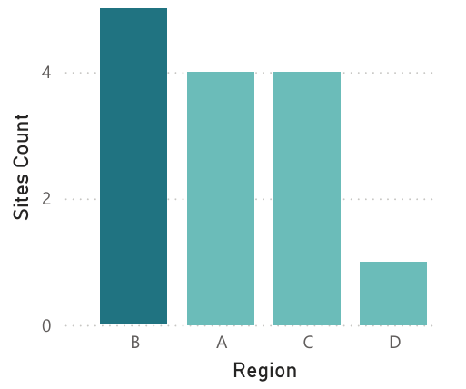
Energy Cost by Demand
Normal demand incurs the highest energy costs, significantly surpassing high and low demand, with a total of 3,505,674.42, indicating that most energy costs are driven by periods of normal demand.
Num of Sites by Region
The distribution of sites across regions reveals that Region B has the highest number of sites (5), followed by Regions A and C with 4 sites each, and Region D with the lowest, having just 1 site.

Slide 19
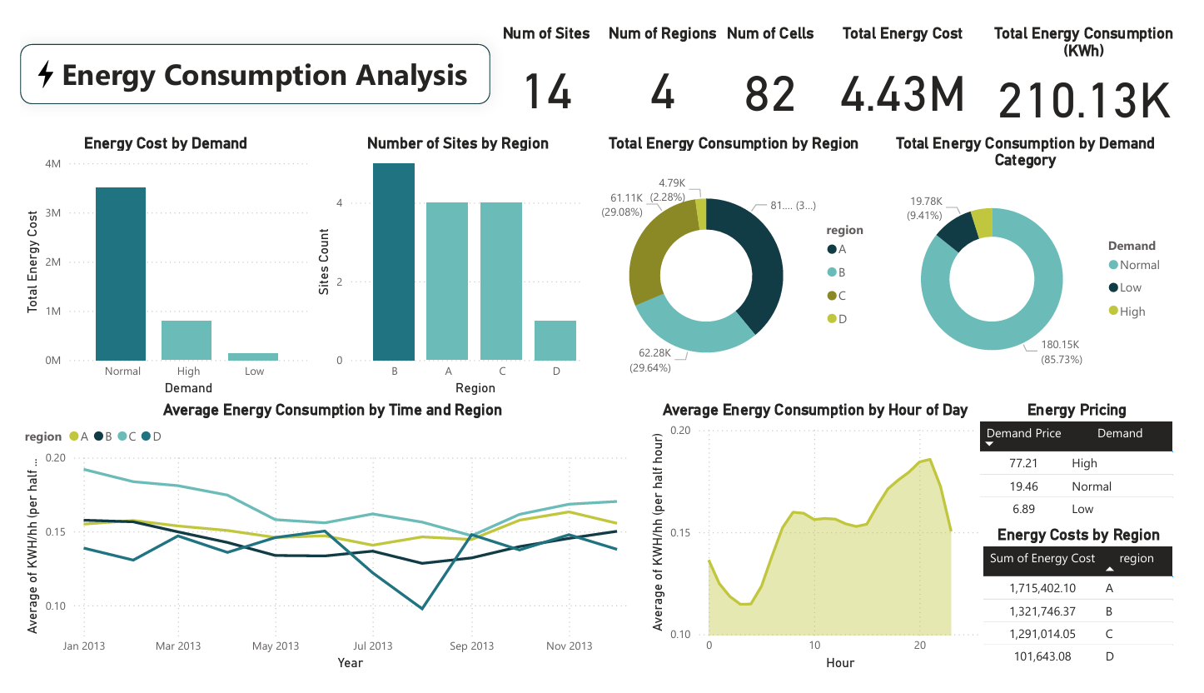

Slide 20
04
Statistical Hypothesis Testing

Slide 21
Does the region significantly affect energy consumption?
Objective
Using ANOVA, Test if the region significantly affects energy consumption.
Hypotheses
Null Hypothesis (H₀): No significant difference in energy consumption between regions.
Alternative Hypothesis (H₁): Significant difference in energy consumption across regions.
Key Results
F-value: 3715.53 (Large difference between group means compared to within-group variability)
P-value: 0.0 (Significant, reject H₀)
Effect Size (η²): 0.008 (Small effect size, suggesting the difference is noticeable but not large)
Assumptions Checked
Normality: Shapiro-Wilk test revealed a violation of normality (p-value < 0.05).
Homogeneity of Variances: Levene’s test showed a violation of equal variances (p-value = 0.0).
Limitations
Non-Normality: Results of ANOVA might not be reliable due to the violation of normality.
Heteroscedasticity: The violation of homogeneity of variance could affect the robustness of ANOVA.
Conclusion
The results suggest a significant difference in energy consumption across regions, but the violations of normality and homogeneity of variance indicate that alternative methods like Welch’s ANOVA could be more appropriate.

Slide 22
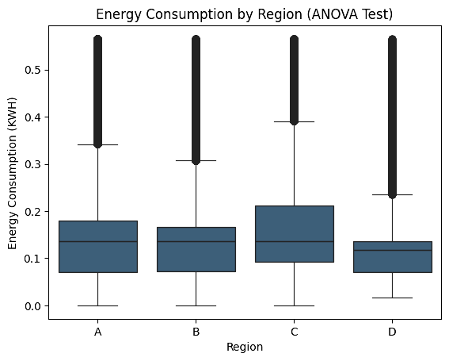
Energy Consumption by Region (ANOVA Test)

Slide 23
Is there a relationship between the time of day and energy consumption?
Objective
Using Spearman's Correlation, to Examine if there is a monotonic relationship between the hour of the day and energy consumption.
Key Results
Spearman Correlation Coefficient (r): 0.175867 (Weak positive correlation)
P-value: 0.0 (Statistically significant, unlikely to be due to random chance)
Assumptions Checked
Monotonic Relationship: The weak correlation suggests a positive monotonic relationship, although not strong.
Data Type: Spearman’s rank correlation is appropriate for ordinal and continuous data.
Limitations
Weak Correlation: The weak correlation suggests that other factors may influence energy consumption, not just the hour of the day.
Outliers: Sensitivity to outliers, which can distort the correlation results.
Conclusion
The relationship between the hour of the day and energy consumption is statistically significant, though weak.

Slide 24
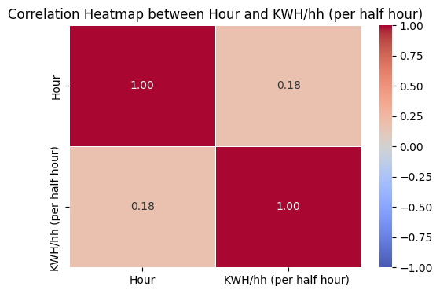
Correlation Heatmap between Hour and KWH/hh (per half hour)

Slide 25
05
Threshold Recommendation and Cost Savings

Slide 26
Threshold Determination
Goal
Determine a threshold to identify low-energy-consuming cells.
Method Used
Calculated threshold using the 25th percentile of the energy consumption data (KWH/hh).
This value represents the point below which the lowest 25% of energy consumption values lie, which corresponds to 344,247 rows × 10 columns of data.
Why the 25th Percentile?
The 25th percentile highlights low-energy usage, meaning these cells consume minimal energy.
These cells are candidates for shutdown or optimization to reduce overall energy consumption and costs.
Identifying Low-Consumption Cells
Cells with energy consumption below the threshold (0.078 KWH/hh).
These cells are analyzed for potential energy and monetary savings.

Slide 27
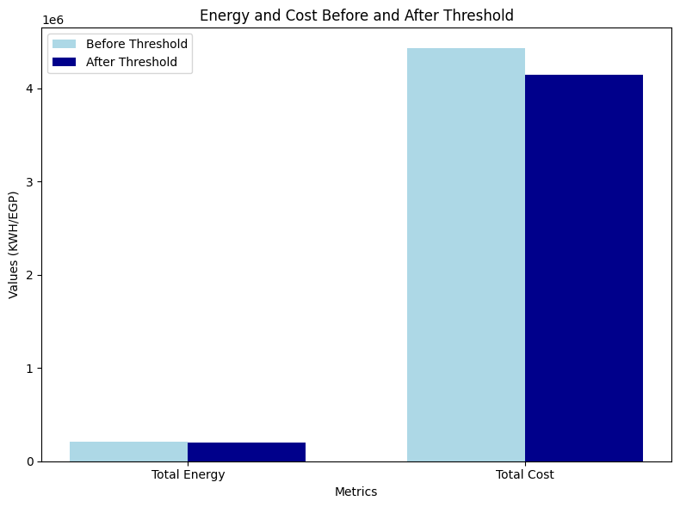
Cost Savings Comparison
13,868,37 KWH
Energy Savings
283,216,00 EGP
Cost Savings
Before Threshold
Total Energy: 210,131.59 KWH.
Total Cost: 4,429,805.61 EGP.
After Threshold
Total Energy: 196,263.22 KWH.
Total Cost: 4,146,589.61 EGP.

Slide 28
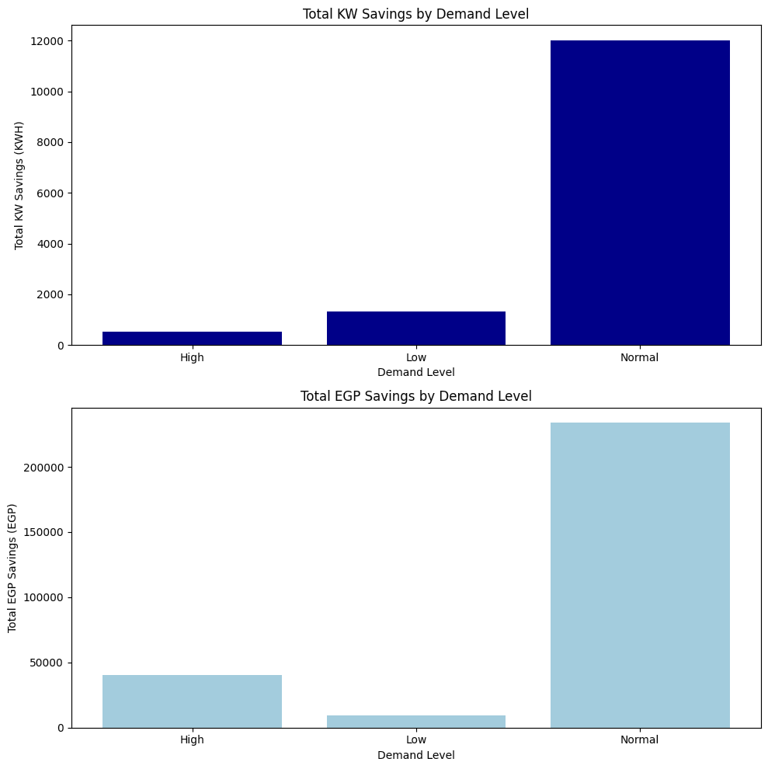
Savings Breakdown by Demand Level
High Demand
Energy Savings: 521.51 KWH.
Cost Savings: 40,265.94 EGP.
Low Demand
Energy Savings: 1,334.90 KWH.
Cost Savings: 9,197.49 EGP.
Normal Demand
Energy Savings: 12,011.95 KWH.
Cost Savings: 233,752.57 EGP.

Slide 29
Recap Key Insights
Throughout this analysis, we identified the 25th percentile as the threshold for low energy consumption, targeting opportunities for cost and energy savings. By focusing on cells below this threshold:
Energy savings: 13,868.37 KWH
Cost savings: 283,216.00 EGP
Additionally, the breakdown by demand levels provided actionable insights, with the Normal demand level contributing the highest savings, emphasizing its significance for optimization.
Highlight the Impact
This approach demonstrates how a data-driven strategy can lead to tangible benefits:
Operational Efficiency: Reducing energy waste while maintaining performance in critical areas.
Sustainability Goals: Aligning with broader efforts to minimize environmental impact.
Cost Optimization: Significant monetary savings, highlighting the financial viability of implementing this strategy.

Slide 30
Thanks!

